Slide 1
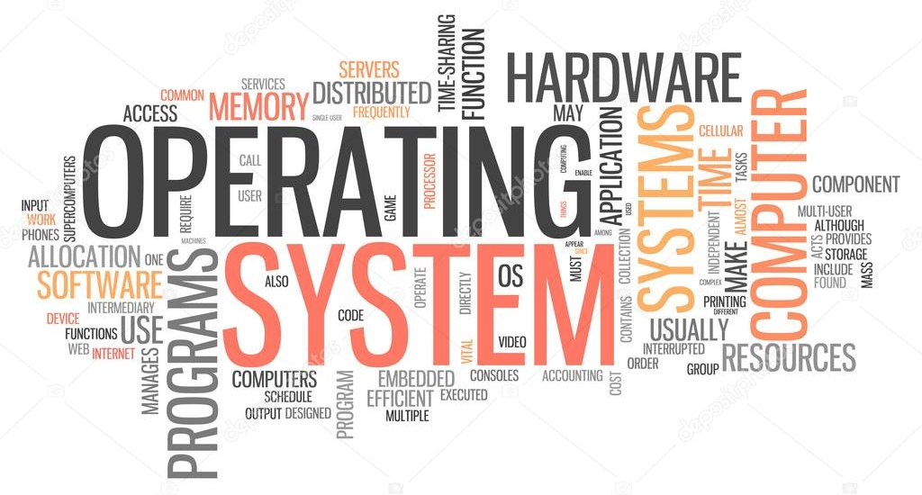
Operating System
Basic concepts of OS

Slide 2
What is Computer?
The computer is an electronic device that takes input from the user and processes these data under the control of a set of instructions (called program) and gives the result (output) and saves it future use.
It can process both numerical and non-numerical (arithmetic and logical) calculations.
The term computer is derived from the Latin term ‘computare’, this means to calculate or programmable machine.
Computer can not do anything without a Program. It represents the decimal numbers through a string of binary digits.

Slide 3
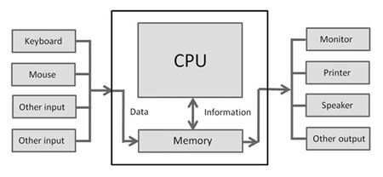
The Word ‘Computer’ usually refers to the Central Processing Unit plus Internal memory.
Charles Babbage is called the “Grand Father” of the computer.
Alan Turing is called the “Father” of computer system.
The First mechanical computer designed by Charles Babbage was called Analytical Engine. It uses read-only memory in the form of punch cards.
Structural Diagram of a Computer System

Slide 4
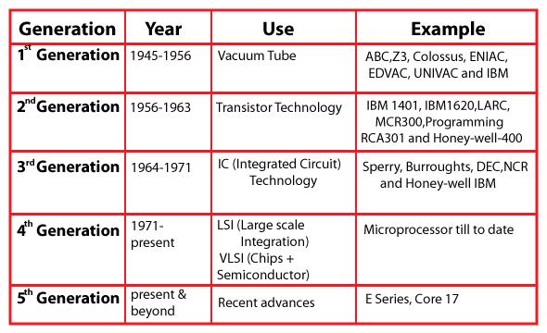
Generations of Computer

Slide 5
Functions of Computer
A computer can process data, pictures, sound and graphics. They can solve highly complicated problems quickly and accurately.
A computer performs basically five major computer operations or functions irrespective of their size and make. These are –
1) it accepts data or instructions by way of input, 2) it stores data, 3) it can process data as required by the user, 4) it gives results in the form of output
5) it controls all operations inside a computer.

Slide 6
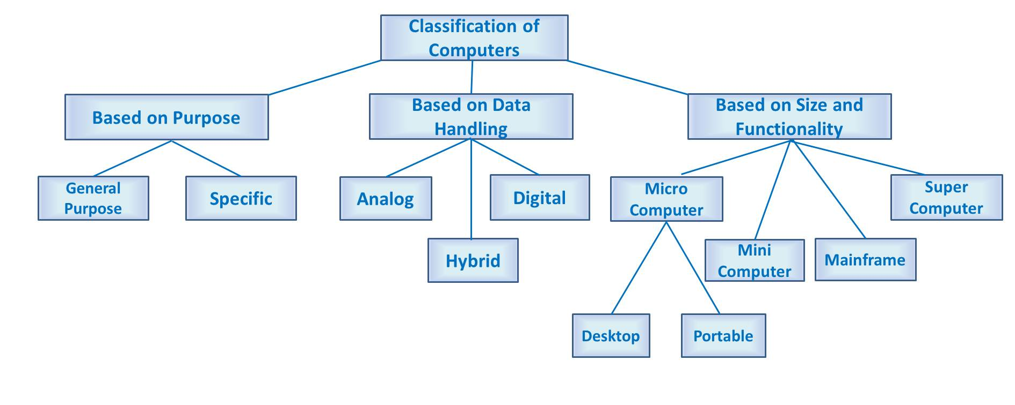
Classification of Computer

Slide 7
Basic Components of Digital Computer
The basic components of a modern digital computer are:
Input Device
Output Device
Central Processing Unit (CPU)
Storage Device (HDD)
Memory (RAM)
A Typical modern computer uses LSI Chips.
Note:
- Large - Scale Integration (LSI) is the process of integrating or embedding thousands of transistors on a single silicon semiconductor microchip.
- LSI Technology was conceived in the mid-1970s when computer processor microchips were under development.

Slide 8
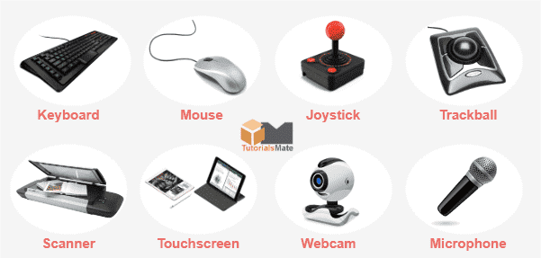
Definition of Input Device
An input device is essentially a piece of instrument or hardware that allows users to provide data, information, or control instructions to a computer used for interaction and control.
Data is entered into a computer in a raw format, which is converted into computer understandable language by input devices and processed by a central processing unit (CPU) to produce output.

Slide 9
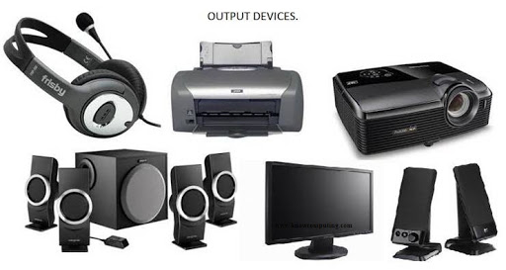
Definition of Output Device
An output device is a piece of computer hardware that receives data from a computer and then translates that data into another form. That form may be audio, visual, textual, or hard copy such as a printed document.
The key distinction between an input device and an output device is that an input device sends data to the computer, whereas an output device receives data from the computer.

Slide 10
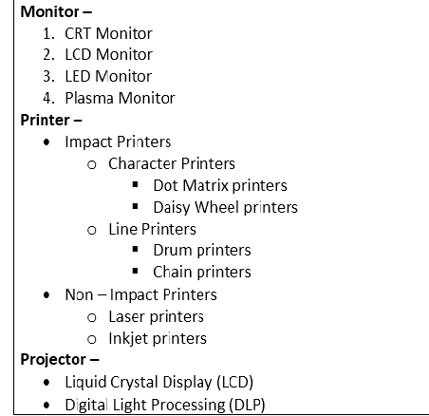
State the different types of Output Devices

Slide 11
Definition of CPU
A Central Processing Unit is also called a processor, central processor, or microprocessor. It carries out all the important functions of a computer.
It receives instructions from both the hardware and active software and produces output accordingly.
It stores all important programs like operating systems and application software.
CPU also helps Input and output devices to communicate with each other.
Owing to these features of CPU, it is often referred to as the brain of the computer.

Slide 12
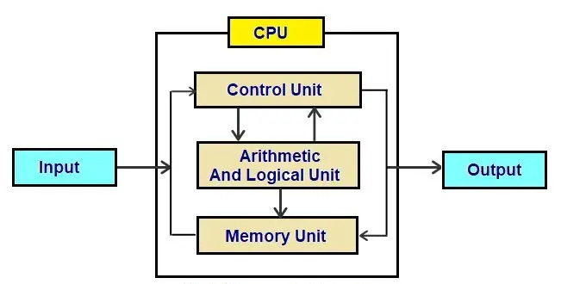
Definition of CPU
A CPU has three components –
ALU (Arithmetic Logic Unit)
Control Unit
Memory or Storage Unit

Slide 13
What do you mean by ALU
(Arithmetic Logic Unit)?
It is the arithmetic logic unit, which performs arithmetic and logical functions.
Arithmetic functions include addition, subtraction, multiplication division, and comparisons.
Logical functions mainly include selecting, comparing, and merging the data.
A CPU may contain more than one ALU. Furthermore, ALUs can be used for maintaining timers that help run the computer.
In some microprocessor architectures, the ALU is divided into the arithmetic unit (AU) and the logic unit (LU).
ALU is also known as an Integer Unit (IU).

Slide 14
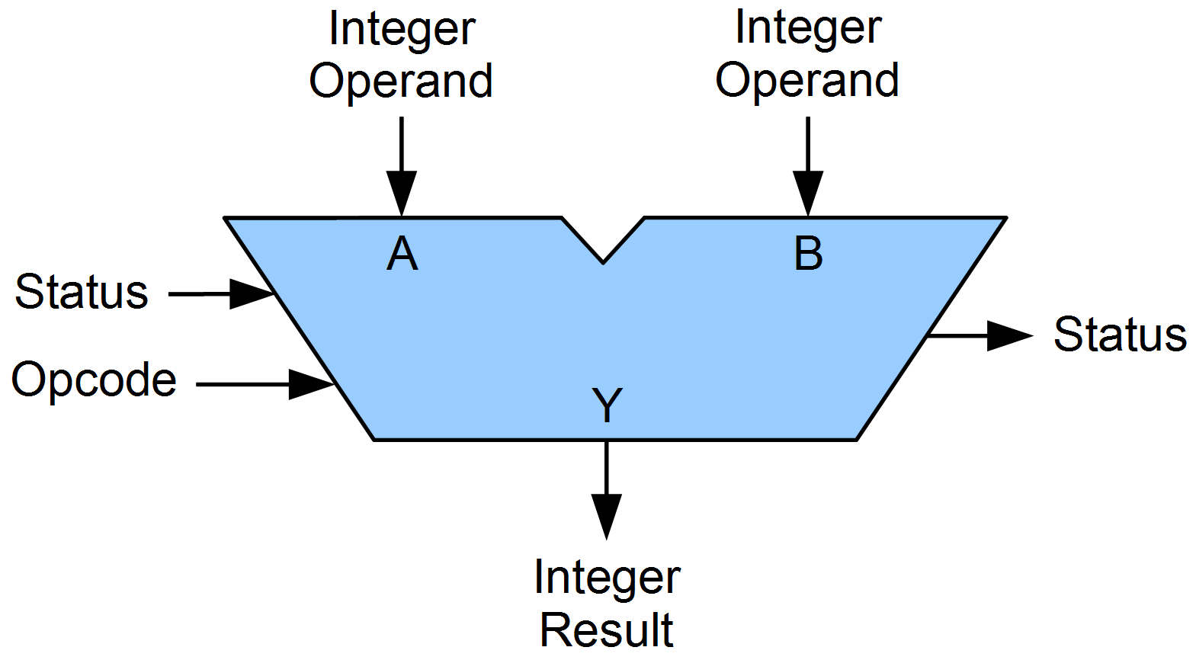
Block Diagram of ALU

Slide 15
What do you mean by Control Unit?
It is the circuitry in the control unit, which makes use of electrical signals to instruct the computer system for executing already stored instructions.
It takes instructions from memory and then decodes and executes these instructions.
So, it controls and coordinates the functioning of all parts of the computer.
The Control Unit's main task is to maintain and regulate the flow of information across the processor.
It does not take part in processing and storing data.

Slide 16
Functions of Control Unit
Functions of this unit are –
It is responsible for controlling the transfer of data and instructions among other units of a computer.
It manages and coordinates all the units of the computer.
It obtains the instructions from the memory, interprets them, and directs the operation of the computer.
It communicates with Input/output devices for transfer of data or results from storage.
It does not process or store data.

Slide 17
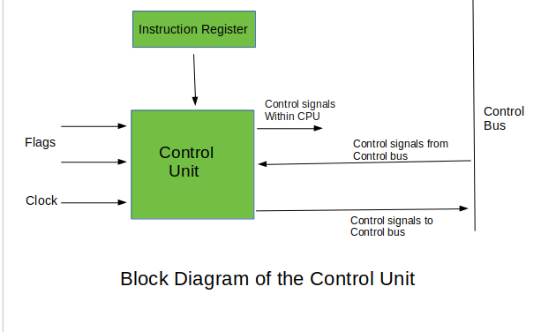
There are two types of Control Unit – Hardwired Control Unit Micro-programmable Control Unit

Slide 18
What do you mean by Memory/Storage Unit?
Memory Unit is a component of a computer system. It is used to store data, instructions and information. It is actually a work area of computer, where the CPU stores the data and instruction.
It is also known as a main/primary/internal memory.
There are two types of memory –
Read Only Memory (ROM) - ROM is a part of the memory unit. This is read only memory. It can not be used to written. ROM is used in situations where the data must be held permanently.
Random Access Memory (RAM) - RAM is also part of memory unit. It is used for temporary storage of program data. Its data is lost when power is turned off.

Slide 19
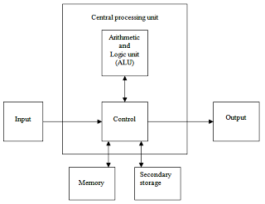
Structure of Memory/Storage Unit

Slide 20
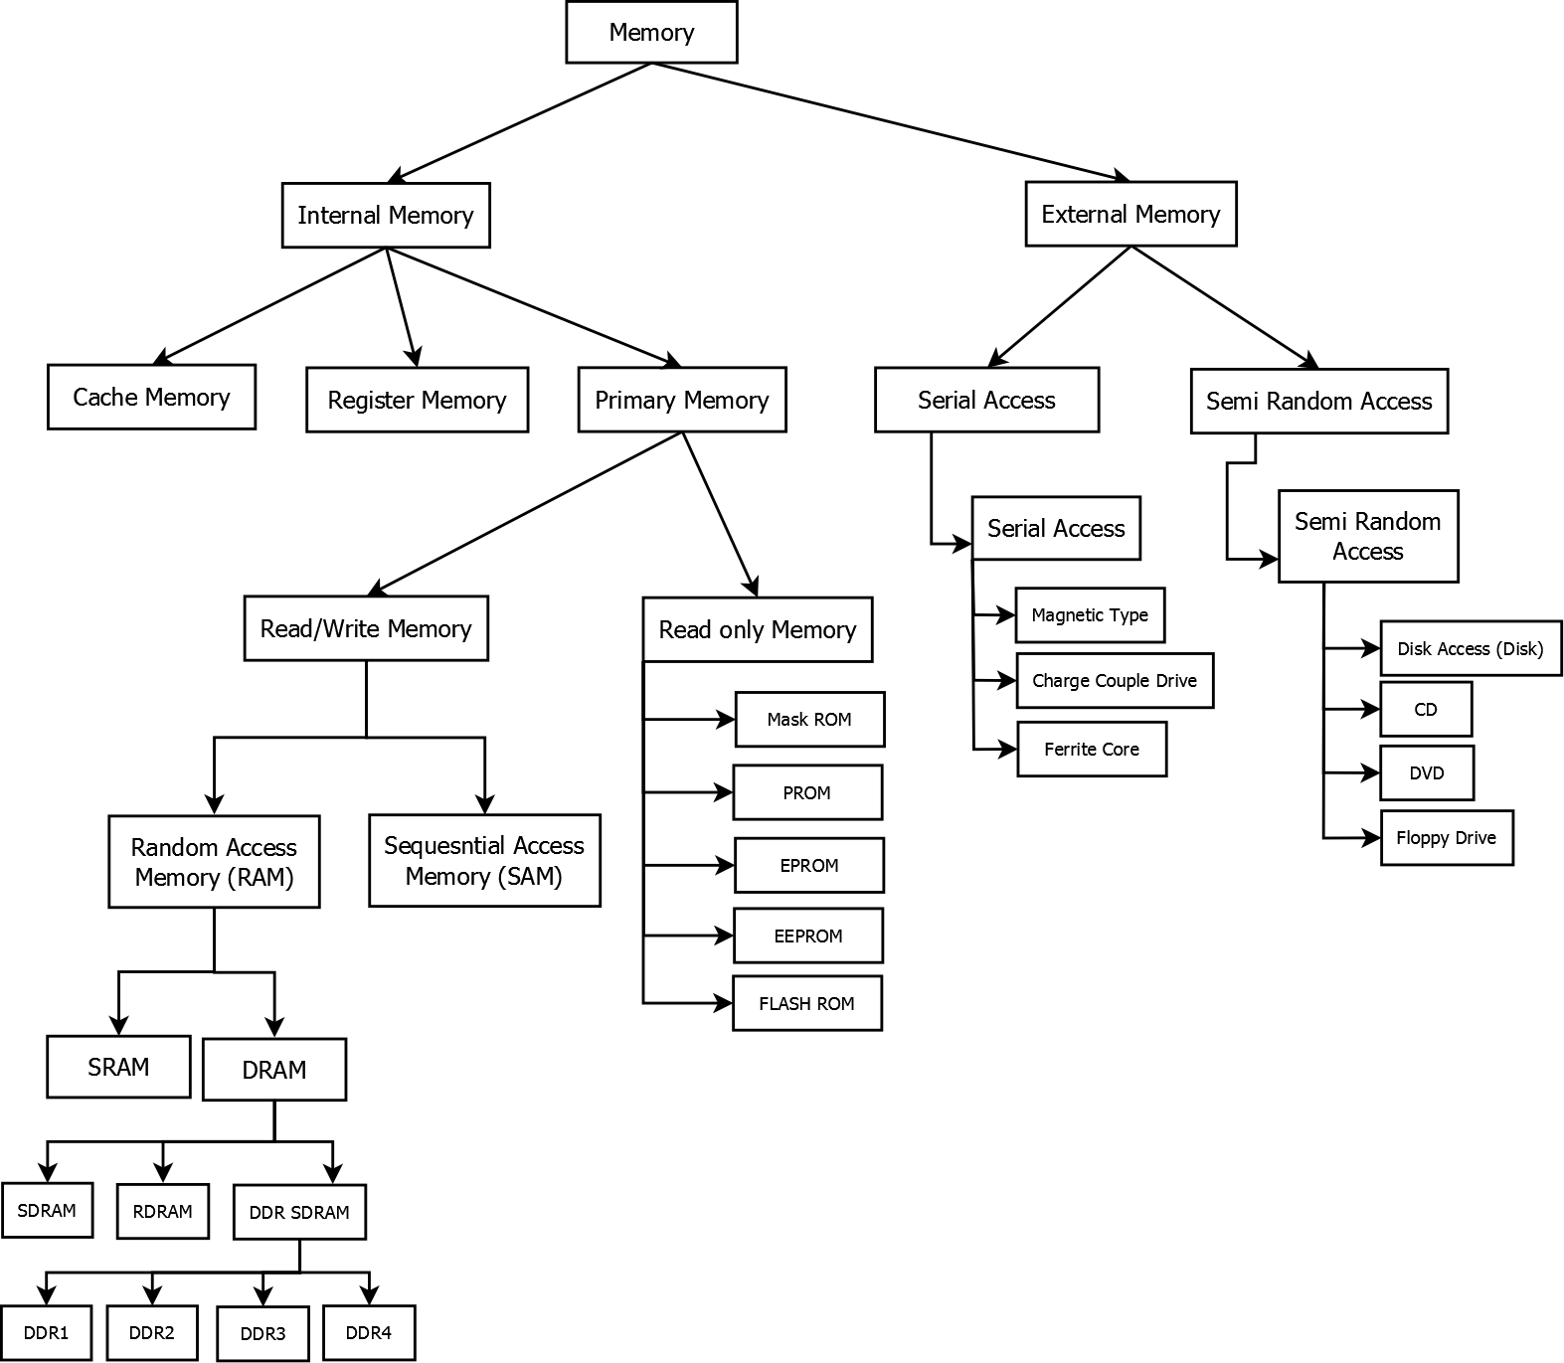
Types of Memory/Storage Unit

Slide 21
What is CPU Clock Speed?
The clock speed of a CPU or a processor refers to the number of instructions it can process in a second.
It is measured in gigahertz (GHz)
For example, a CPU with a clock speed of 4.0 GHz means it can process 4 billion instructions in a second.

Slide 22
Types of CPU
CPUs are mostly manufactured by Intel and AMD, each of which manufactures its own types of CPUs. Some of the basic types of CPUs are described below –
Single Core CPU - Single Core is the oldest type of computer CPU, which was used in the 1970s. It has only one core to process different operations. It can start only one operation at a time; the CPU switches back and forth between different sets of data streams when more than one program runs. So, it is not suitable for multitasking as the performance will be reduced if more than one application runs. The performance of these CPUs is mainly dependent on the clock speed. It is still used in various devices, such as smartphones.

Slide 23
Dual Core CPU - As the name suggests, Dual Core CPU contains two cores in a single Integrated Circuit (IC). Although each core has its own controller and cache, they are linked together to work as a single unit and thus can perform faster than the single-core processors and can handle multitasking more efficiently than Single Core processors.
Quad Core CPU - This type of CPU comes with two dual-core processors in one integrated circuit (IC) or chip. So, a quad-core processor is a chip that contains four independent units called cores. These cores read and execute instructions of CPU. The cores can run multiple instructions simultaneously, thereby increases the overall speed for programs that are compatible with parallel processing.

Slide 24
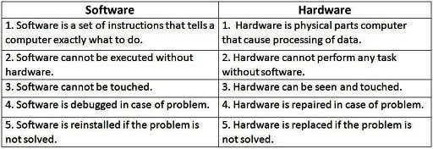
NOTE: Quad Core CPU uses a technology that allows four independent processing units (cores) to run in parallel on a single chip. Thus by integrating multiple cores in a single CPU, higher performance can be generated without boosting the clock speed. However, the performance increases only when the computer's software supports multiprocessing. The software which supports multiprocessing divides the processing load between multiple processors instead of using one processor at a time.

Slide 25
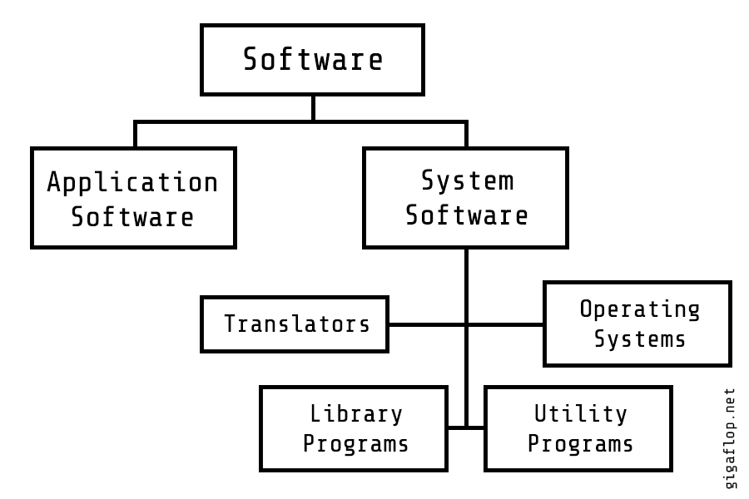
Classification of Software

Slide 26
High Level Language (HLL)
A high level language, is a programming language that enables development of a program in a much more user- friendly programming context and is generally independent of the computer hardware’s architecture.
A high level language, has a higher level of abstraction from the computer and focuses more on programming logic rather than the understanding hardware components such as memory addressing and register utilization.
For example – C, C++, C#, Java etc.

Slide 27
Low Level Language (LLL/L3)
A low level language, is a programming language that provides little or no abstraction on programming language and it is very close to writing actual machine instructions.
For example – Assembly Language & Machine Language

Slide 28
Block diagram of Computer Language Hierarchy
Source Code
Written by the programmer
HLL
Translate the Code by Compiler or Interpreter
Assembly Language
Low Level Language
Translate the Code by Assembler
Machine Language
Output
Display

Slide 29
State the different types of language processors
Translator - A translator is a program that converts source code into object code. Generally, there are three types of translator: compilers, interpreters, assemblers
Source Code -> Translator -> Object Code ->Machine Code
Compiler - Compiler is a computer programs which converts a high level language (Source Language) to low level language (Object/Target/Machine Language).
1. It read a whole program at a time
2. It translates the whole program at a time into the machine code
3. It produces machine code which is directly understood by computer
4. It takes large amount of time to analyze the source code
5. It is faster
6. It requires more memory space
7. It is good for professionals
8. C, C++ are using compiler

Slide 30
Interpreter - An interpreter translates high-level instructions into an intermediate form, which it then executes.
1. It read the program line by line
2. It translates only one line of program at a time into machine code
3. It produces intermediate code after translation
4. It takes less amount of time to analyze the source code
5. It is slower
6. It requires less memory space
7. It is good for beginners
8. Python, Ruby are using Interpreter
Assembler - An assembler translates assembly language programs into machine code. The output of an assembler is called an object file, which contains a combination of machine instruction as well as the data required to place these instructions in memory.

Slide 31
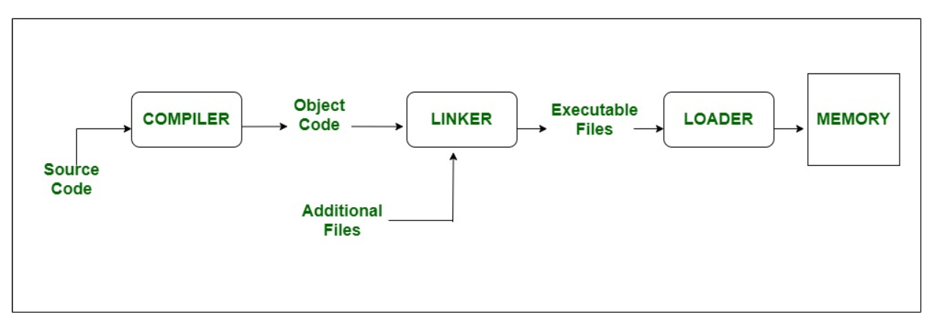
Loader - Loader is a part of operating system and is responsible for loading executable files into memory and execute them. It calculates the size of a program (instructions and data) and create memory space for it. It initializes various registers to initiate the execution.
Macro - Macro is a single line abbreviation for group of instructions. With the help of macro, programmer can define a single "instruction" to represent block of code.

Slide 32
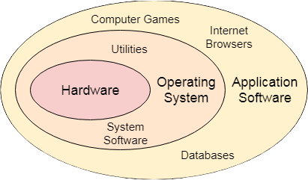
What do you mean by Operating System?
An operating system (OS) is system software that manages a computer's hardware and software resources and provides common services for computer programs. It acts as an intermediary between users, application programs, and the computer hardware, enabling applications to interact with hardware without needing to manage hardware details directly.
e.g. Windows, Unix, Linux, Mac OS etc.

Slide 33
What are the objectives of Operating System?
There are two major design objective of OS –
1. It provides a friendly and convenient environment for user to develop application programs.
It can control various resources like CPU, Memory, IO files etc.
NOTE: The OS also has the capability to resolve the conflicts for a resource that arise by different user programs.

Slide 34
To be continued…
What are the goals of Operating System?
Execute user programs and make solving user problems easier.
Make the computer system convenient to use.
Use the computer hardware in an efficient manner.
What are main functions of Operating System?
Managing the user’s programs
Managing the memories of computer
Managing the I/O operations
Controlling the security of computer

Slide 35
Advantages Operating System?
It is helpful to monitor and regulate resources.
It can easily operate since it has a basic graphical user interface to communicate with your device.
It is used to create interaction between the users and the computer application or hardware.
The performance of the computer system is based on the CPU.
The response time and throughput time of any process or program are fast.
It can share different resources like fax, printer, etc.
It also offers a forum for various types of applications like system and web application.

Slide 36
Dis-advantages Operating System?
It allows only a few tasks that can run at the same time.
It any error occurred in the operating system; the stored data can be destroyed.
It is a very difficult task or works for the OS to provide entire security from the viruses because any threat or virus can occur at any time in a system.
An unknown user can easily use any system without the permission of the original user.
The cost of operating system costs is very high.

Slide 37
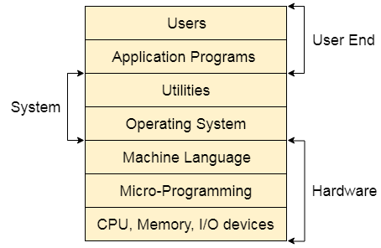
What is the structure of Operating System?
A Computer System consists of:
Users (people who are using the computer)
Application Programs (Compilers, Databases, Games, Video player, Browsers, etc.)
System Programs (Shells, Editors, Compilers, etc.)
Operating System ( A special program which acts as an interface between user and hardware )
Hardware ( CPU, Disks, Memory, etc)

Slide 38
What does an Operating System do?
Process Management
Memory Management
File System Management
Device Management
Multi-mode Execution

Slide 39
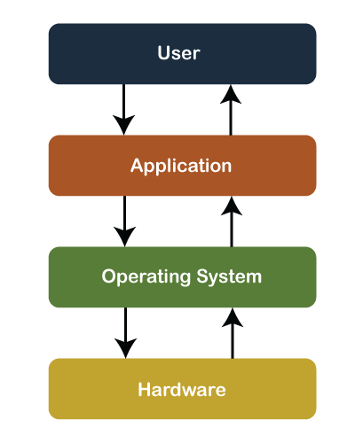
Operational diagram of an Operating System

Slide 40
Functions of Operating System
Processor management
Act as a Resource Manager
Memory Management
File Management
Security
Device Management
Input devices / Output devices
Deadlock Prevention
Time Management
Coordinate with system software or hardware

Slide 41
Types of Operating System
Batch Operating System
Time-Sharing Operating System
Embedded Operating System
Multiprogramming Operating System
Network Operating System
Distributed Operating System
Multiprocessing Operating System
Real-Time Operating System

Slide 42
Batch Operating System
In Batch Operating System, there is no direct interaction between user and computer. Therefore, the user needs to prepare jobs and save offline mode to punch card or paper tape or magnetic tape. After creating the jobs, hand it over to the computer operator; then the operator sort or creates the similar types of batches like B2, B3, and B4. Now, the computer operator submits batches into the CPU to execute the jobs one by one. After that, CPUs start executing jobs, and when all jobs are finished, the computer operator provides the output to the user.

Slide 43
Time-Sharing Operating System
It is the type of operating system that allows us to connect many people located at different locations to share and use a specific system at a single time. The time-sharing operating system is the logical extension of the multiprogramming through which users can run multiple tasks concurrently. Furthermore, it provides each user his terminal for input or output that impacts the program or processor currently running on the system. It represents the CPU's time is shared between many user processes. Or, the processor's time that is shared between multiple users simultaneously termed as time-sharing.

Slide 44
Embedded Operating System
The Embedded operating system is the specific purpose operating system used in the computer system's embedded hardware configuration. These operating systems are designed to work on dedicated devices like automated teller machines (ATMs), airplane systems, digital home assistants, and the internet of things (IoT) devices.

Slide 45
Multiprogramming Operating System
A multiprogramming operating system refers to the concepts wherein two or more processes or programs activate simultaneously to execute the processes one after another by the same computer system. When a program is in run mode and uses CPU, another program or file uses I/O resources at the same time or waiting for another system resources to become available. It improves the use of system resources, thereby increasing system throughput. Such a system is known as a multiprogramming operating system.

Slide 46
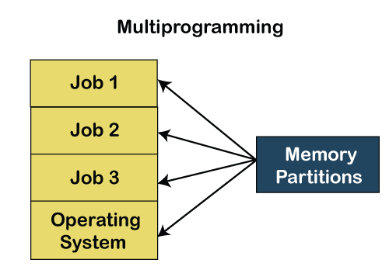

Slide 47
Network Operating System
A network operating system is an important category of the operating system that operates on a server using network devices like a switch, router, or firewall to handle data, applications and other network resources. It provides connectivity among the autonomous operating system, called as a network operating system. The network operating system is also useful to share data, files, hardware devices and printer resources among multiple computers to communicate with each other.

Slide 48
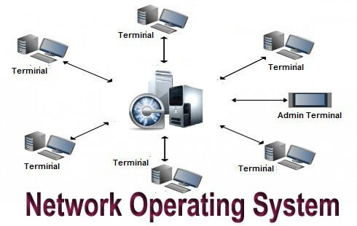

Slide 49
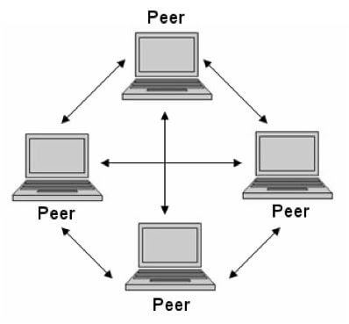
Peer-to-peer network Operating System
The type of network operating system allows users to share files, resources between two or more computer machines using a LAN.

Slide 50
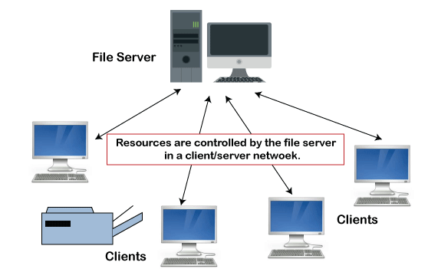
It is the type of network operating system that allows the users to access resources, functions, and applications through a common server or center hub of the resources. The client workstation can access all resources that exist in the central hub of the network. Multiple clients can access and share different types of the resource over the network from different locations.
Client-Server network Operating System

Slide 51
Distributed Operating System
A distributed operating system provides an environment in which multiple independent CPU or processor communicates with each other through physically separate computational nodes. Each node contains specific software that communicates with the global aggregate operating system. With the ease of a distributed system, the programmer or developer can easily access any operating system and resource to execute the computational tasks and achieve a common goal. It is the extension of a network operating system that facilitates a high degree of connectivity to communicate with other users over the network.

Slide 52
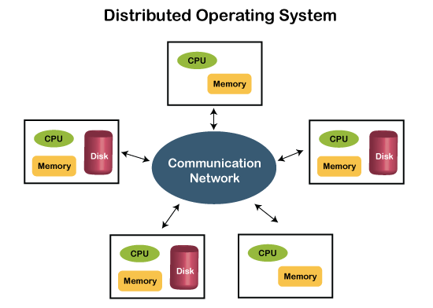

Slide 53
Multiprocessing Operating System
It is the type of operating system that refers to using two or more central processing units (CPU) in a single computer system. However, these multiprocessor systems or parallel operating systems are used to increase the computer system's efficiency. With the use of a multiprocessor system, they share computer bus, clock, memory and input or output device for concurrent execution of process or program and resource management in the CPU.

Slide 54
Real-Time Operating System
A real-time operating system is an important type of operating system used to provide services and data processing resources for applications in which the time interval required to process & respond to input/output should be so small without any delay real-time system.

Slide 55
Hard Real-Time System
These types of OS are used with those required to complete critical tasks within the defined time limit. If the response time is high, it is not accepted by the system or may face serious issues like a system failure. In a hard real-time system, the secondary storage is either limited or missing, so these system stored data in the ROM.

Slide 56
Soft Real-Time System
A soft real-time system is a less restrictive system that can accept software and hardware resources delays by the operating system. In a soft real-time system, a critical task prioritizes less important tasks, and that priority retains active until completion of the task. Also, a time limit is set for a specific job, which enables short time delays for further tasks that are acceptable.
For example, computer audio or video, virtual reality, reservation system, projects like undersea, etc.

